Slide 1
DRY COPPER SLAG ATOMIZATION: ON SITE LABORATORY-PILOT SCALE TRIALS AT COPPER SMELTER FACILITY
Title
Slag Valorisation Symposium
1-5 April 2019
Mechelen, Belgium

Slide 2
INDEX
Atlantic Copper overview
Project background
Pilot plant test
Conclusion
Notes:
My presentation consists, first a few words about my Company, AC, followed by a background of the project where I will explain why we decided to carry out the pilot plant, which I will describe, and it finishs with a Conclusion (conclusssion) and the next steps scheduled.

Slide 3
INDEX
Atlantic Copper overview
Project background
Pilot plant test
Conclusion
Notes:
So, let me start with the Atlantic Copper overview…Ac

Slide 4
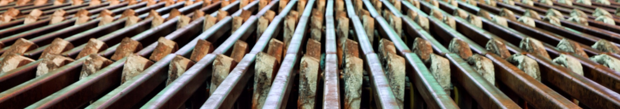
Atlantic Copper
    Spanish Company belonging to the leading US natural resource company, Freeport McMoRan
    Production of high-grade refined copper from ore mined in various parts of the World
    Atlantic Copper is the third largest smelter and refinery in Europe. It is the biggest copper producer in Spain
    #77 in the 2017 Spanish ranking in sales volume (1,789 MM €)
    First Andalusian Company in exports 2017 (966 MM €)
    Huelva Works started Operations in 1970
    A work team with long metallurgical tradition
Notes:
So, let me start with the Atlantic Copper overview…Ac is a spanish Company…….

Slide 5
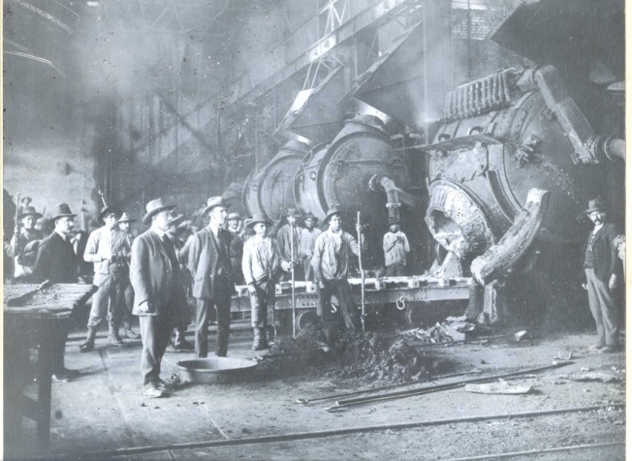
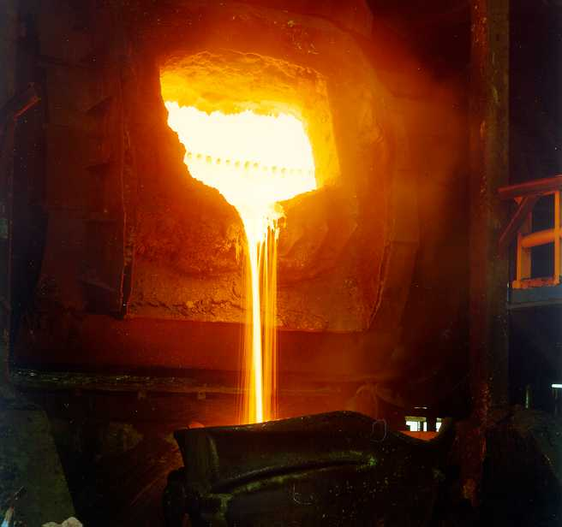
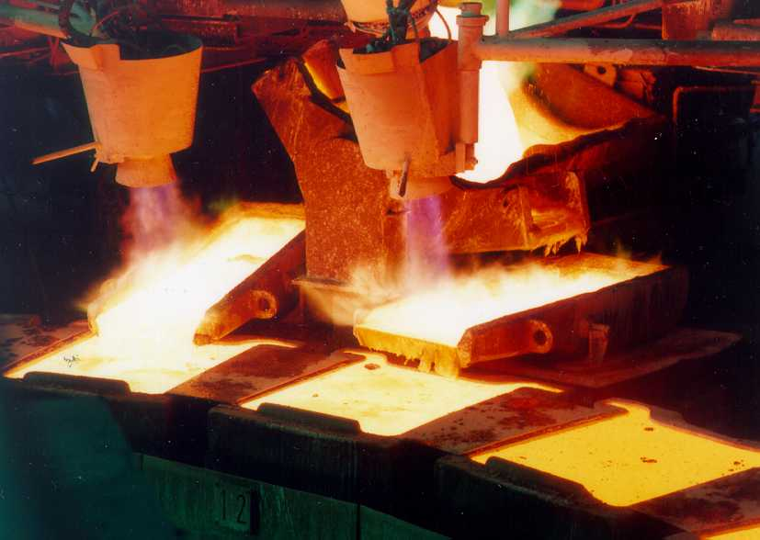
Atlantic Copper
The History
1873: British investors acquired the Rio Tinto mining reserves from the Spanish government and founded the RIO TINTO COMPANY LTD.
1873-1970: Mining and Smelting operations at Riotinto village, 75 Km northwest of Huelva, prosperously developed.
1970: Huelva Smelter & Refinery start-up. Initial capacity 40,000 tpy copper cathodes.
1975: Commissioning of the Flash furnace (Outokumpu) and Tankhouse expansion to 108,000 tpy cathodes.
1985: First oxygen enriched air used at the Flash Furnace (over the fence supply).
1993: Acquisition of 100% Atlantic Copper shares by Freeport.
1994: Huelva Expansion Project, doubling capacity.
1997: Debottlenecking Project to reach 1 million tpy fresh concentrate and 260 ktpy cathodes.
2011: Tank house capacity increased to 290ktpy.
2013-2017: Several energy efficiency projects were excuted.
Notes:
In this slide with can have an review of the AC´s history, the keys moments that I would like to remark are, first that the Huelva Smelter start up was in 1970´, in that moment the production capacity was 40,000 tpy of copper cathodes. The second moment is in 1993 when AC was bought by FM, and the following years several investments were made in order to increase the capacity till the current one that is 290 thoundsands tm/year. The last years the company has been focused on efficiency energy investments.

Slide 6
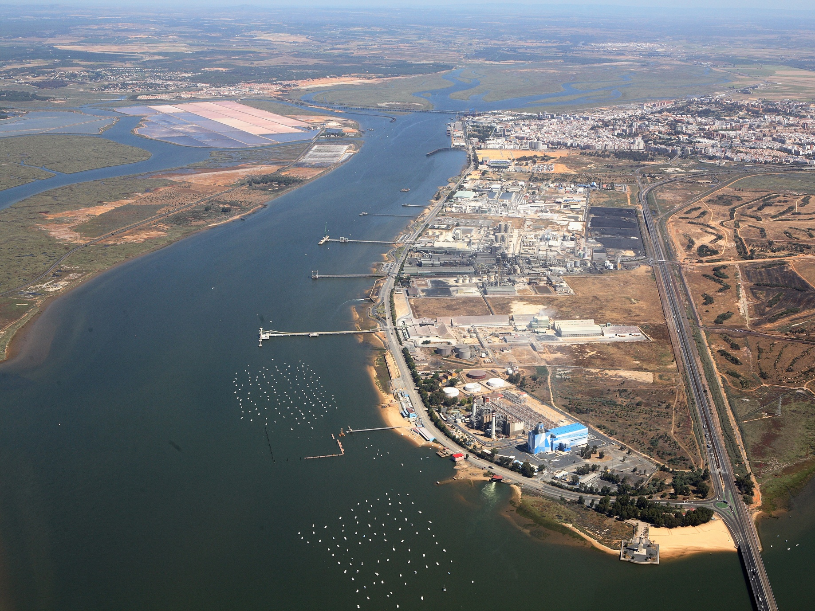
Notes:
This is picture of AC localization. It is close to a City and in front of a protected natural park. This can give you an idea about the high environmental commitment that the Company has in relation of the environment.

Slide 7
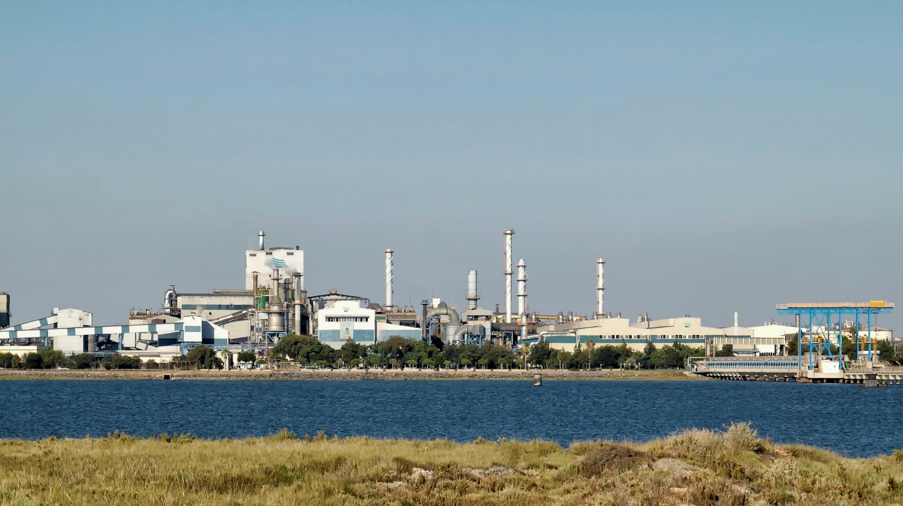
Plantas de ácido
Notes:
This is other nice view of our facility

Slide 8
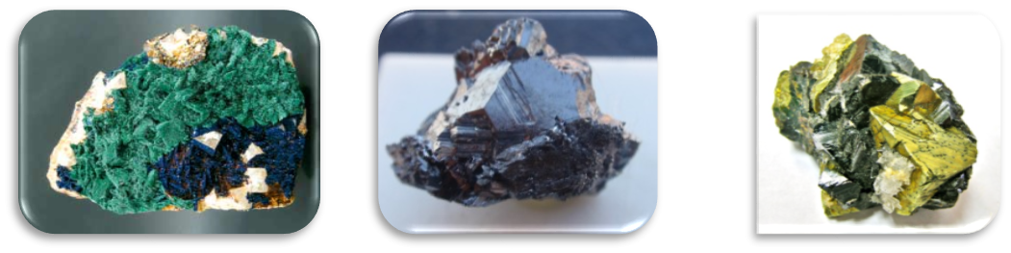
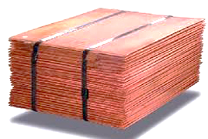
The Process
Flotation
Ore 0.5-2% Cu
Concentrate 25-30% Cu
Fe
S
Smelting
Ferric
Silicate
Slag
Acid Plants
Sulfuric acid
(98%)
Iron silicate
Matte 65% Cu
Conversion
Blister 99% Cu
Refining & Casting
Au, Ag
Anode 99.5% Cu
Anode slimes
Electrorefining
Cathodes 99.99% Cu
Other By-products: Te, Ni
Notes:
And in this slide you can see a simplified diagram of the AC process, in summary:
AC transforms Copper concentrate into pure copper (cathode, it is a commodity), and in other products like iron silicate, Sulphuric acid and anode slimes to be sold. This is the part of the process in which the test was made.

Slide 9
Production and Sales
2018 production records
Smelted concentrates___ 1,103 kdt
Sulfuric acid___________ 1,078 kt
2018 Sales
Cathodes_______________ 283 kt
Copper | Anodes | 12 kt ,
 | Cathodes | 283 kt ,
Precious metals | Gold | 7 t ,
 | Silver | 80 t ,
Other products | Silicate | 658 kt ,
 | Sulfuric acid | 1,077 kt,
kt smelted concentrates
_______________
Note* - 2011/2013/2015/2017 includes impact by major maintenance scheduled shutdowns.
Note ** - 2015 equivalent smelting rate was 1.094 Kt.
Notes:
This slide is just to have an idea of the production and sales level. We can have a quick look at the figures.

Slide 10





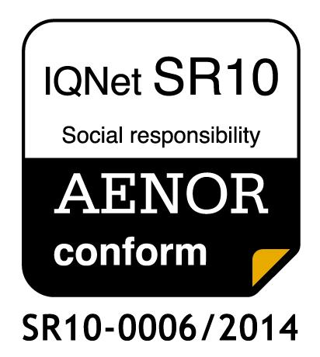
Management Standards
Certificate for Quality Management System (ISO 9001) since 1994.
Certificate for Environmental Management System (ISO 14001) since 1998.
Registered in the European System Eco-Management and Audit Scheme (EMAS) since 1999.
All Atlantic Copper technologies and processes are Best Available Techniques (BAT) as per EU Directive 96/61 IPPC.
IPPC Integrated Environmental Permit (AAI) awarded November 2007.
Certificate for OHSAS Safety Management System (ISO 18001) since 2011.
Certificate for Energy Management System (ISO 50001) since 2011.
Certificate IQNet SR10:2015 Social Responsibility Management System since 2014.
Certificate as Healthy Company since 2018 (AENOR RP-CSG-033).
GE 009/2011
Notes:
And finally, in this slide I´d like to show in terms of System management that AC has obtained certificate in quality, environment, Safety, Energy, and , even in Social Responsibility and as a Healthy Company, that shows our commitment to Society (societi)

Slide 11
INDEX
Atlantic Copper overview
Project background
Pilot plant test
Conclusion
Notes:
Let´s move on the Project background and

Slide 12
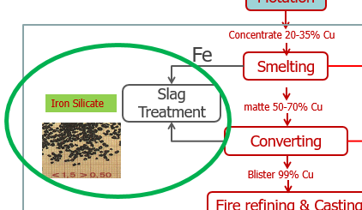


Copper slags (iron silicate)
The European copper sector generates approximately 5 million tons of iron silicates during copper production by the pyrometallurgical route, containing valuable metals and other compounds.
Traditionally, copper slags were considered as undesirable “waste” materials that had to be discarded at an additional cost.
This material is considered a product by Atlantic Copper because it can be used for several applications in the construction sector (but it has a low value in the market).
There are significant environmental, operational and economic challenges like Water consumption and wastewater generation, Energy loss , Limited Valorisation (the water-granulated slag has a low market value). Technical standards are highly restrictive, and the inclusion of a new material into existing standards is not easy to implement.
There is an innovative technology to produce the copper slag in a more sustainable and environmentally friendly way
Notes:
As I said before, In the pyrometallurgical copper smelting process the main product is copper but there are other products generated in consequence of the copper extraction of the ore, this is the case of the Iron Silicates (commonly called copper slags) which are the largest co-product generated during the smelting and converting processes of the pyrometallurgical route: for every ton of copper production about 2.2 ton of copper slag is generated.
There are significant environmental, operational and economic challenges related to the current slag treatment method like Water consumption and wastewater generation, Energy loss (the current global process for the copper production involves important Energy consumption, Limited valorisation of the slag (the water-granulated slag has a low market value). Technical standards are highly restrictive, and the inclusion of a new material into existing standards is not easy to implement.
In 2015 an innovative technology to produce the copper slag in a more sustainable and environmentally friendly way was filed (failed) to AC

Slide 13
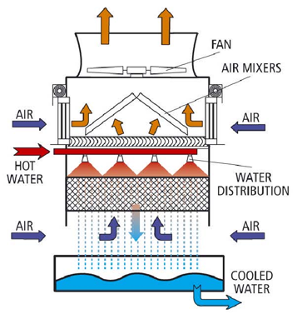
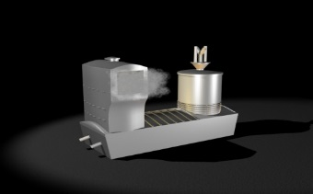


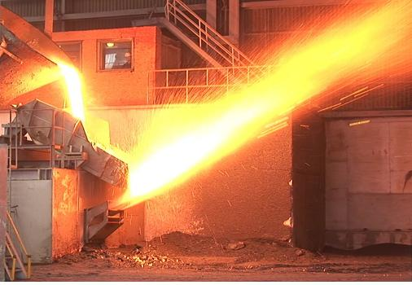

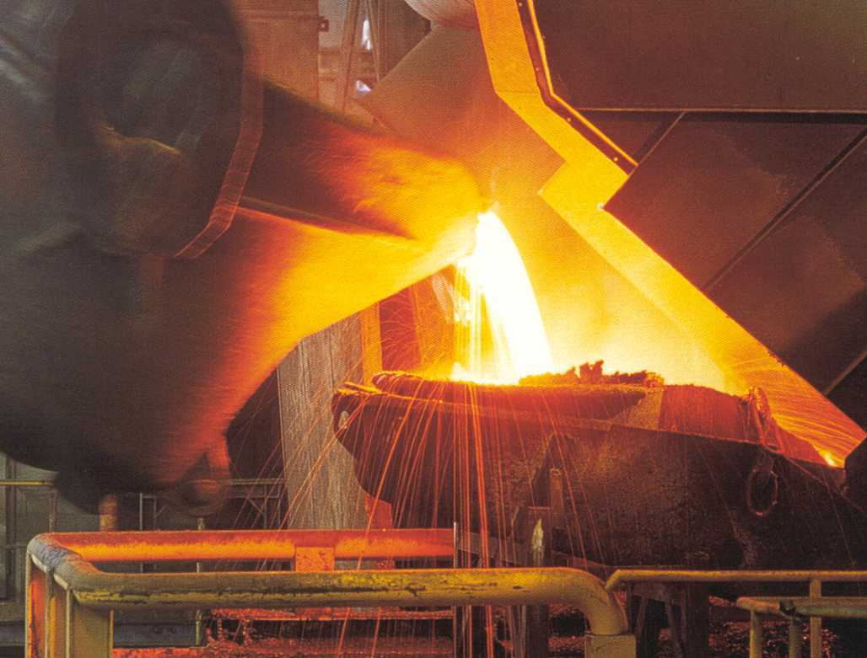
WATER GRANULATION
(current process)
Water to
granulate
LIKELY BENEFITS
WATER COOLING CIRCUIT
Electric
Furnace
Ferric
silicate (slag) 1.3 % Cu
water consumption:
682.000 tons per year
Flash
Furnace
purge: 20 m3/h (146.100 m3/year)
Ferric silicate (slag) 0,8-1 % Cu
Water cooling towers
Ferric silicate (slag)
8% Cu
Converter
Furnace
Waste water treatment plant
Water effluent
DRY AIR GRANULATION
HATCH property technology
(process to validate)
Heat recovery system
Ferric silicate (slag)
1.3 % Cu
Hot Air (1.700 ºC)
Flash
Furnace
Ferric silicate (slag) 0,8 % Cu
Air
Ferric silicate (slag)
8% Cu
Converter
Furnace
Notes:
The technology that was filed to AC was a dry-granulation process developed by HATCH. This technology is based on an air-granulation system in which the molten slag is dispersed by a jet of air and produce granulate iron silicate. This dry granulation could constitute a solution to the challenges related to the current slag treatment method previously exposed. :
To explain this innovative technology, please, let me explain the current water Slag granulation versus with new process proposed

Slide 14
Dry granulation Technology: pros and cons
With the incorporation of this INNOVATIVE TECHNOLOGY (DRY ATOMIZATION TECHNOLOGY for FERRIC SILICATE) in the pyro-metallurgical system for copper concentrated treatment, the benefits that would be obtained could be
Benefits:
Sustainability increase: water consumption reduction and heat recovery (cost reduction)
Avoiding explosions risks (due molten material in contact with water)
Ferric silicate upgrade: Improve product quality. New applications: added economic value in the actual market
Atlantic Copper decided to carry out some tests of the Ecomaister-Hatch air atomization at laboratory-pilot scale in the smelter facilities
¿Why?
High Uncertain: There are no similar plants in the copper industry. It is not validated.
¿Objetive?
To VERIFY: Quality of the iron silicate granulate.
The main objective was to study and determine the effects of air atomization on the composition, leaching and granulometry of the slag when molten slag is quenched and granulated by means of air atomization.
Notes:
So doing a preliminary reflexion…With the incorporation of…..we can assume that there are some benefits,,,,but spite of those benefits…AC decided to DO THE TEST….Because there is a high uncertain that is----there are no. (As HATCH manteins…)
the technology-based company, HATCH, which had developed a dry atomization technology for iron silicate, Ecomaister-HATCH Eco2STAR. This technology is being currently implemented on a large scale in Asia in plants for the treatment of steel, zinc and SiMn slag. However, it has not been adapted yet to treat copper slag in any copper smelter worldwide.¹⁻²

Slide 15
INDEX
Atlantic Copper overview
Project background
Pilot plant test
Conclusion
Notes:
Now We are in the description of the pilot plant test…

Slide 16
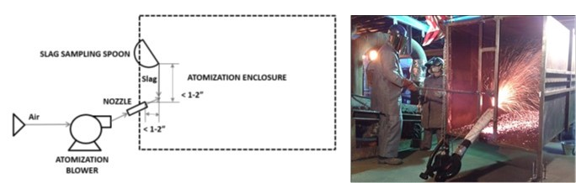
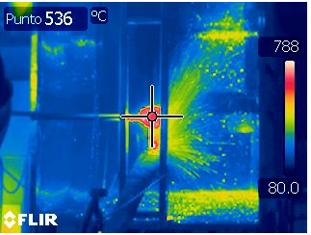
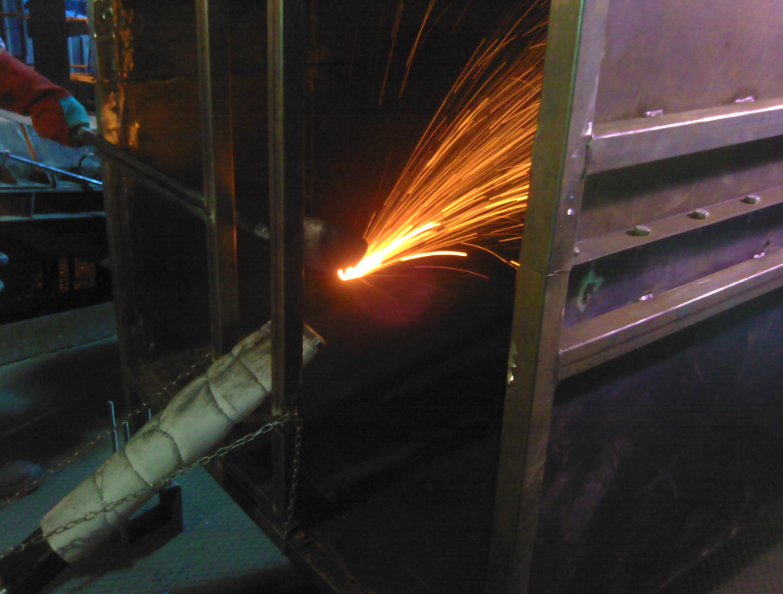
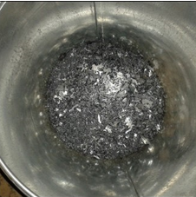
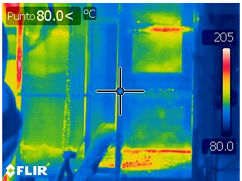
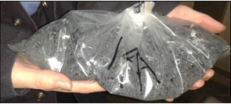
Pilot test 2015: method and description
The laboratory-pilot was installed by HATCH at the Atlantic Copper facilities.
video
Slag Temperature Measurement
Slag Flow Rate Measurement
Samples collection
Notes:
The laboratory-pilot was installed by HATCH at the Atlantic Copper facilities. A scheme and a picture are shown in Figure. To give a better idea of the test, we can see the next video.
You can see The operator preheats a ladle spoon in slag stream before taking the sample and quickly move over to blower and the molten slag is discharged/pouring into a slag-feeding chute located in front of the atomization chamber... An air jet from an atomizer granulates and quenches the molten slag into the granulation chamber.
During the process, some measures were made like:
Slag Temperature Measurement
Using a pyrometer, the temperature of the surface of the slag was measured before atomization begins (when the operator is preheating the ladle spoon), once the slag sample is taken by the operator and immediately after atomization is completed
Slag Flow Rate Measurement
The slag flow rate was calculated measuring the duration of the discharge carried out by the operator and weighting the slag mass at the end of the atomization when the operator is discharging the slag for atomization.
After each test the cooled and solified granules (graniuls) were collected, labeled and analyzed in a external laboratories.
in addition to temperature and slag flow rate, other data are collected, such as the air flow rate and the angle of incidence of the air with respect to slag flow
Test conditions/measurements
The first one consists in the preparation of isolated samples, in different conditions of the process (slag temperature, bath level) and different pouring conditions (blower speed, spoon emptying rhythm). This experiment was repeated to have a wide range of samples to analyze.
The second phase is based on continuous granulated slag production. At this stage, the flow of the blower was not set to a fixed setpoint.
During the third phase, a portable thermocouple is used, focusing the slag flow to that point in order to measure the temperature during the process. The measurement probe was located in such way that was possible to measure the temperature of the slag during all the process. In addition, a thermal imager was used outside the chamber to check the temperature.

Slide 17
  parameters vs tests
Summary of test runs completed. The acronyms noted in the runs represent: HVLR = High Velocity, Low air-to-slag Ratio, HVHR = High Velocity, High air-to-slag Ratio, LVLR = Low Velocity, Low air-to-slag Ratio LVHR = Low Velocity, High air-to-slag Ratio, HVoutlier = High Velocity data points that are well above the targeted air-to-slag ratio, HVmid = High Velocity data points midway between air-to-slag ratio targets. LVmid = Low Velocity data points midway between air-to-slag ratio targets.
Notes:
Results
In each test different parameter were changing in other to cover the maximum variations.
In this figure we can provide a visual summary of the completed test runs.
And what were the results???

Slide 18
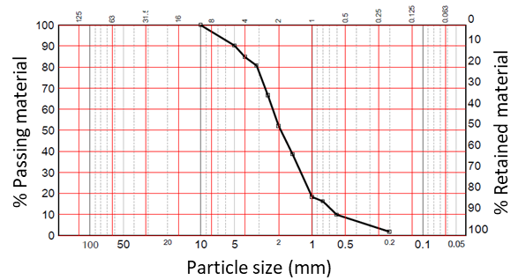
  Results: physical analysis
Size distribution: The samples collected were pre-sieved, rejecting particles >1 cm, and calculating the yield as the percentage of particles <1 cm. The bulk was sieved in many different sizes, from 0.2 mm to 10 mm in order to obtain particle size distribution curve (following the UNE EN 933-1 standard). Main result: over 85% of particles smaller than 4 mm.
Apparent density (UNE 103301) and Mohs hardness. Similar results were found in all samples, showing apparent density around 2.2 g/cm³ and Mohs hardness <7
To compare: typical samples from wet granulation presented:
Apparent density around 3.7 g/cm3,
Mohs hardness >6
Over 80% of particles smaller than 4 mm.
Figure 1: Example of particle size distribution curve, obtained with the bulk of slag samples.
Notes:
We can divided the results in two parts: physical and chemical analysis. In this slide we have the physical analysis…

Slide 19

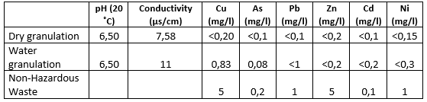

  Results: Chemical composition
Characterization: samples were analysed by XRF, ICP and XRD to determine composition and crystalline vs. amorphous content. The composition barely differs between all the samples prepared. In order to simplify, in table 1 the mean composition of the iron silicate is shown.
Leaching test: samples were analysed according to UNE-EM 12457/4 standard. Almost all of them showed acceptable leaching behaviour to be considered as no-harzardous waste, what gives a vision of how inert is the product. In the following table , a representative result obtained in the leaching analysis is shown
Notes:
And regarding the chemical analysis, the samples were analysed by XRF, ICP and XRD and in the table you can have an idea about the composition.
In addition/moreover/In relation with the leaching test the samples were analysed…..almost…all….blabala and can give you a impress of how inert this product is

Slide 20
  Conclusion
Comparing to water granulation, composition, granulometry and Mohs hardeness were in the same range, while, apparent density decreased, what can be due to a more porous material (further analysis must be carried out).
Regarding leaching analysis, samples obtained by dry granulation showed better features as compared to the current slag, presenting values good enough to be considered as Non-Hazardous waste.
Tests carried out over real molten slag with laboratory-pilot Ecomaister-Hatch air atomization showed that it is possible to obtain adequate quality granulated iron silicate.
Dry granulation process could produce iron silicate with at least the same quality than that obtained by traditional water granulation….But a upscaling to TRL 7-8 should be done.
Notes:
To summarize, I would like to point out some conclusions….
1, 2 y 3----
Having made the previoud observations, the final outcome could be…as a result….

Slide 21







WhISPER: Waterless Iron Silicate Production with Energy Recovery
  Next steps
Atlantic Copper is leading a research Project supported by an European Union R&D Programme (EIT Raw Materials)
The main objective of WhISPER is to validate an innovative and sustainable air-based pyro-metallurgical system to produce iron silicate in the Non-ferrous Metal Industry through the development and implementation of a pilot demonstration plant.
Consortium: Led by Atlantic Copper
Execution:2019-2020-2021
 | Spain (Industry) | Coordination and reporting. Technical supervision. Feasibility study. Pilot plant installation (end user)
 | Germany (University) | Feasibility study EIT: ”Go-to-market”
 | Slovenia (Technology Center) | Chemical and mechanical characterization of the new iron silicate produced with this technology Validation/Certificate applications on the building sector
 | Belgium (University-Company) | Copper slag valorisation-Inorganic Polimers LCA (exergy analysis) & economic sustainability (LCC)
 | France (University) | Educational, Training and Dissemination
INTERNATIONALLY RECOGNIZED RESEARCH ORGANIZATION IN THE FIELD OF CONSTRUCTION
https://recover.technology/
Notes:
Before to finish I would like to tell about the next steps we have scheduled.

Slide 22
Thanks!
Notes:
Thanks for you attention, If you have any questions, I´ll be happy to answer them

Slide 23
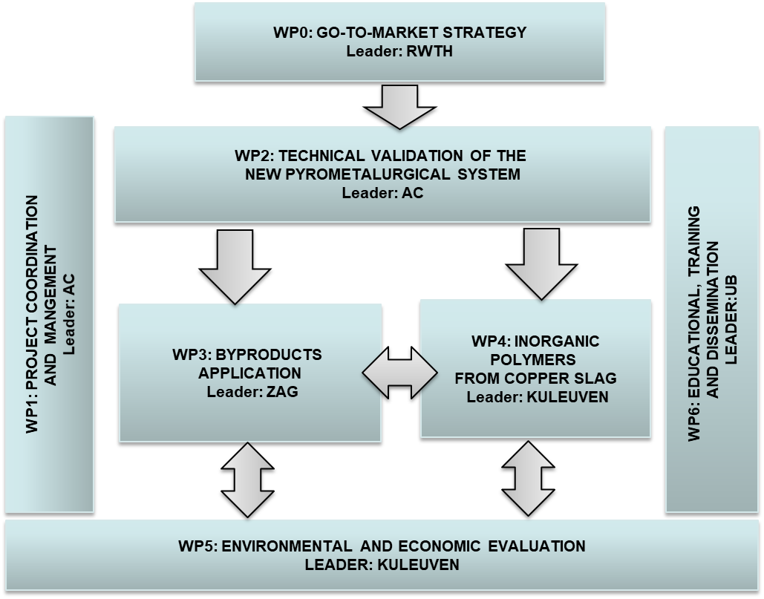
  Work Plan
Technology: TRL 5-7
2019-2021
2019-2020
2020
2020
2020-2021

Slide 24
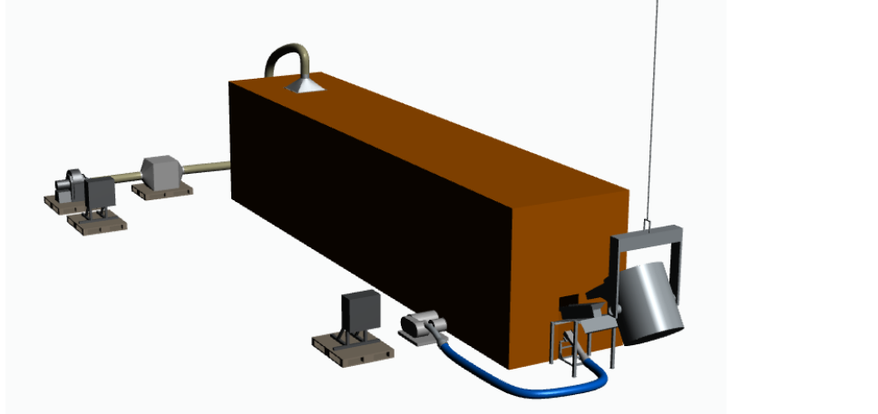
WhISPER: Pilot plant
Installation: general shut down Sept 2019. Pilot Plant operation: Nov-Dec 2019
Ferric silicate production rate: 0.05t/min. It can be assumed to 2.5 to 5 tonnes of sample per week (assuming 5-day week).
Time allowed test: 2-3 months
Sample shipping to partners: Dec. 2019

Slide 25
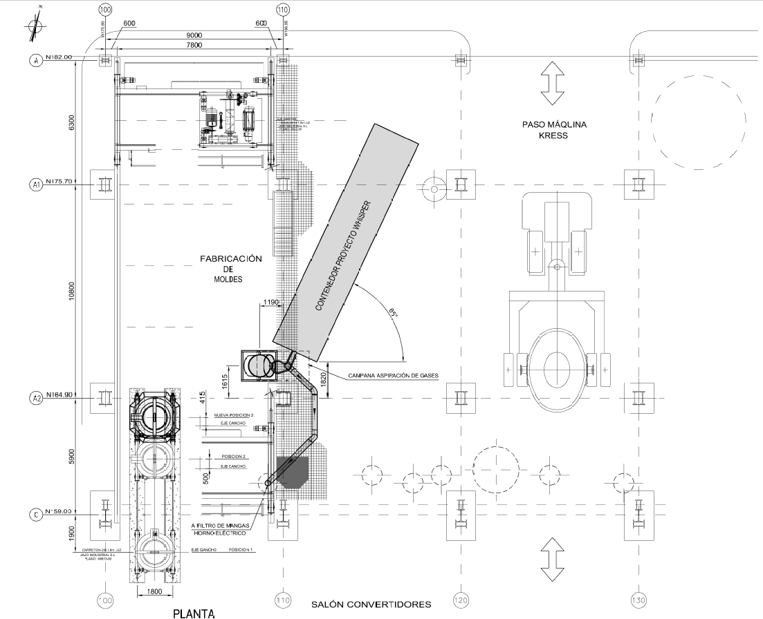
WhISPER: Pilot plant
Installation: general shut down Sept 2019. Pilot Plant operation: Nov-Dec 2019

Slide 26
WhISPER: Pilot plant-scheduled
Installation: general shut down Sept 2019. Pilot Plant operation: Nov-Dec 2019
WP2 (2019): Technical validation | March | Ap-Aug | Sept-oct | Nov-dec | Jan-Feb
AC internal investment approval
Order/procurement modifications construction Pilot (HATCH)
Installation/comissioning
Pilot test
Pilot test (extension)

